Slide 1
Network Models
A network is a combination of hardware and software that sends data from one location to another
Hardware : The hardware consists of the physical equipment that carries signals from one point of the network to another.
Software : The software consists of instruction sets that make possible the services that we expect from a network.

Slide 2
Network Layer Basic Classification
Layered Tasks
OSI Model
TCP / IP Model
Addressing

Slide 3
Layered Tasks
We use the concept of layers in our daily life
Example :
Consider two friends who communicate through postal mail

Slide 4
SENDER
RECEIVER
Letter is written, put in an envelope and dropped in a mailbox
Letter is picked up, removed from the envelope, and read
HIGHER LAYER
Letter is carried from the mailbox to a postoffice
The letter is carried from the post office to the mailbox
MIDDLE LAYER
The letter is delivered to a carrier by the post office
The letter is delivered from the carrier to the post office
LOWER LAYER
The parcel carried from the source to the destination

Slide 5
OSI MODEL
What is ISO ?
Established in 1947, the International Standards Organization (ISO) is a multinational body dedicated to worldwide agreement on international standards.
What is OSI ?
An ISO standard that covers all aspects of network communications is the Open Systems Interconnection (OSI) model. It was first introduced in the late 1970s.

Slide 6
Layered Architecture
APPLICATION LAYER
PRESENTATION LAYER
SESSION LAYER
TRANSPORT LAYER
NETWORK LAYER
DATA LINK LAYER
PHYSICAL LAYER

Slide 7
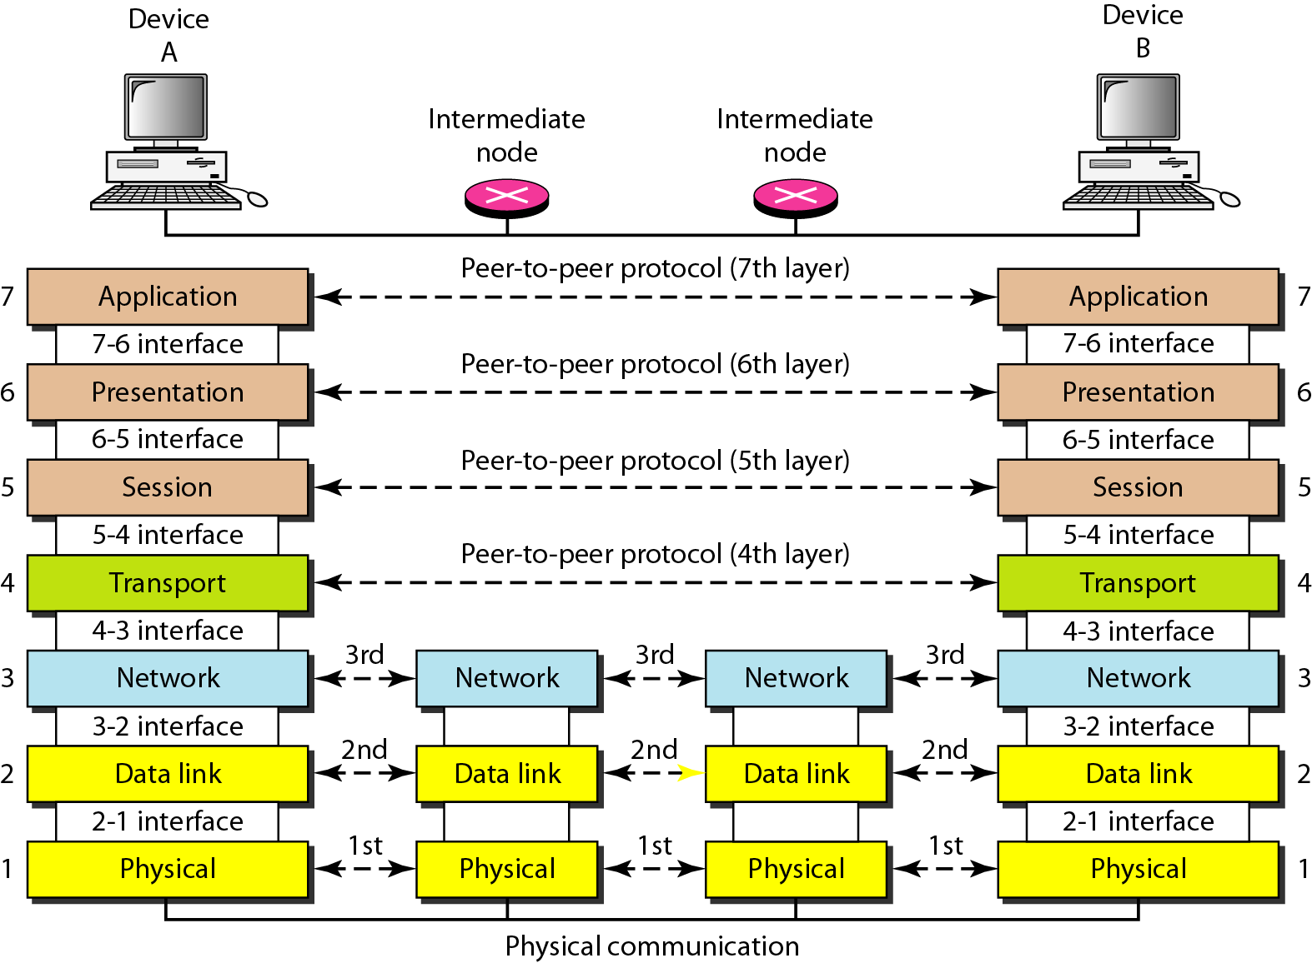
The interaction between layers in the OSI model

Slide 8
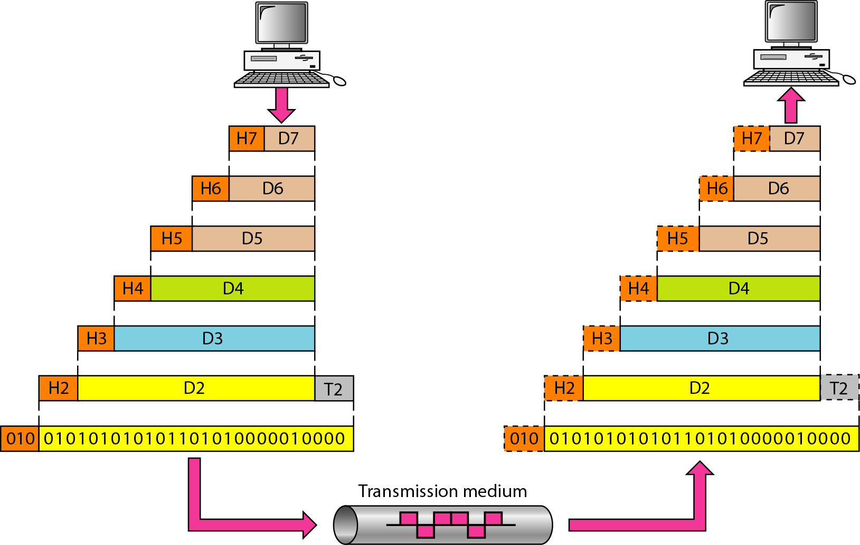
An exchange using the OSI model

Slide 9
PHYSICAL LAYER
This layer includes the physical equipment involved in the data transfer, such as the cables and switches.
This is also the layer where the data gets converted into a bit stream, which is a string of 1s and 0s.
The physical layer of both devices must also agree on a signal convention so that the 1s can be distinguished from the 0s on both devices.

Slide 10
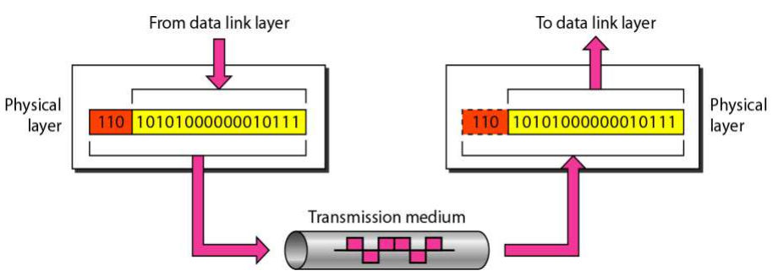
The physical layer is responsible for movements of individual bits from one hop (node) to the next

Slide 11
Physical layer
Responsibility of Physical layer:
Physical characteristic of interface and medium
Representation of bits
Data/Transmission rate
Synchronization of bits
Line configuration
Physical topology
Transmission mode

Slide 12
Data link layer
The data link layer transforms the physical layer, a raw transmission facility, to a reliable link.
The data link layer takes packets from the network layer and breaks them into smaller pieces called frames.
The data link layer is responsible for flow control and error control in intra-network communication.
It makes the physical layer as error-free to the upper layer.

Slide 13
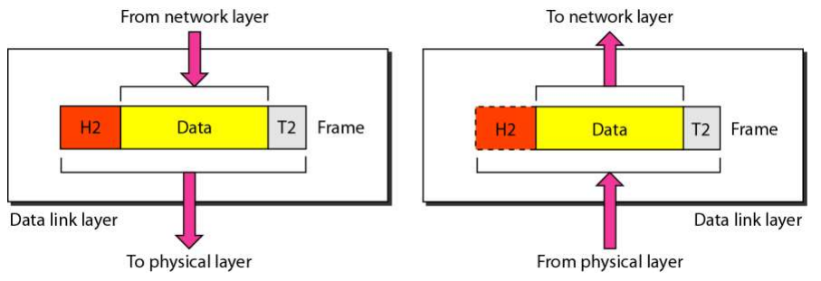
Data link layer
The data link layer is responsible for moving frames from one hop (node) to the next

Slide 14
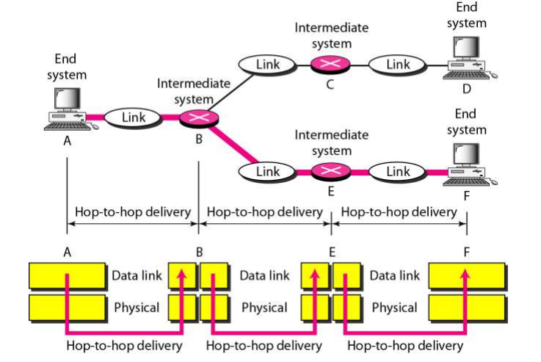
Hop-to-hop delivery

Slide 15
Data Link Layer
Responsibilities of Data Link Layer:
Framing
Physical addressing
Flow control
Error control
Access control

Slide 16
Network layer
The network layer is responsible for facilitating data transfer between two different networks.
If the two devices communicating are on the same network, then the network layer is unnecessary.
The network layer breaks up segments from the transport layer into smaller units, called packets, on the sender’s device, and reassembling these packets on the receiving device.
The network layer also finds the best physical path for the data to reach its destination; this is known as routing.

Slide 17
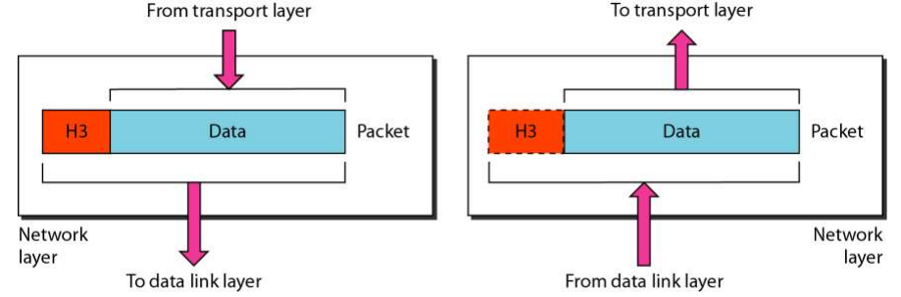
The network layer is responsible for the delivery of individual packets from the source host to the destination host

Slide 18
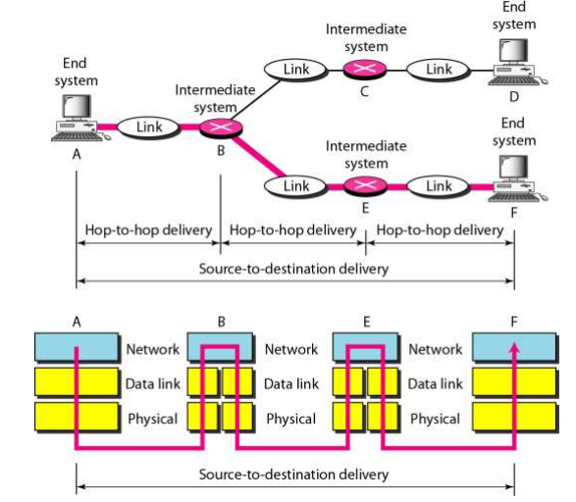
Source-to-destination delivery

Slide 19
Network Layer
Responsibilities of Network Layer:
Logical addressing
Routing

Slide 20
Transport layer
Layer 4 is responsible for end-to-end communication between the two devices. This includes taking data from the session layer and breaking it up into chunks called segments before sending it to layer 3.
The transport layer on the receiving device is responsible for reassembling the segments into data the session layer can consume.
The transport layer is also responsible for flow control and error control.
Flow control determines an optimal speed of transmission to ensure that a sender with a fast connection doesn’t overwhelm a receiver with a slow connection.
The transport layer performs error control on the receiving end by ensuring that the data received is complete, and requesting a retransmission if it isn’t.

Slide 21
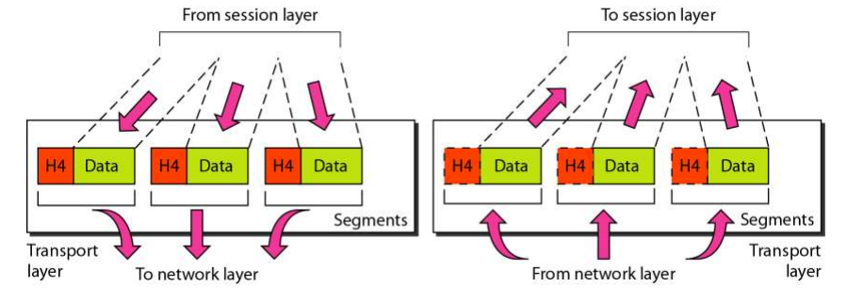
The transport layer is responsible for the delivery of a message from one process to another process.

Slide 22
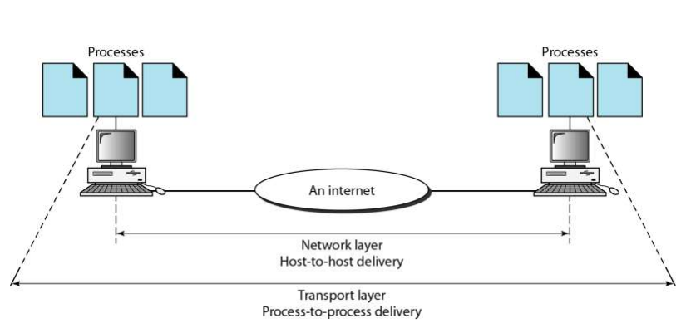
Reliable process-to-process delivery of a message

Slide 23
Transport Layer
Responsibilities of transport layer:
Service point addressing
Segmentation and reassembly
Connection control

Slide 24
Session layer
This is the layer responsible for opening and closing communication between the two devices.
The time between when the communication is opened and closed is known as the session.
The session layer ensures that the session stays open long enough to transfer all the data being exchanged, and then promptly closes the session in order to avoid wasting resources.
The session layer also synchronizes data transfer with checkpoints.

Slide 25
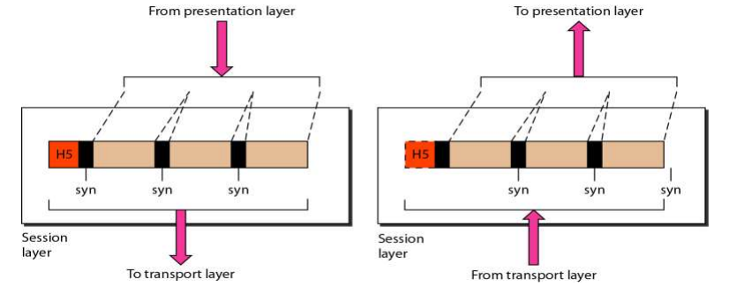
The session layer is responsible for dialog control and synchronization

Slide 26
Presentation layer
This layer is primarily responsible for preparing data so that it can be used by the application layer; in other words, layer 6 makes the data presentable for applications to consume.
The presentation layer is responsible for translation, encryption, and compression of data.
Two communicating devices communicating may be using different encoding methods, so layer 6 is responsible for translating incoming data into a syntax that the application layer of the receiving device can understand.

Slide 27
If the devices are communicating over an encrypted connection, layer 6 is responsible for adding the encryption on the sender’s end as well as decoding the encryption on the receiver's end so that it can present the application layer with unencrypted, readable data.
Finally the presentation layer is also responsible for compressing data it receives from the application layer before delivering it to layer 5.
This helps improve the speed and efficiency of communication by minimizing the amount of data that will be transferred.

Slide 28
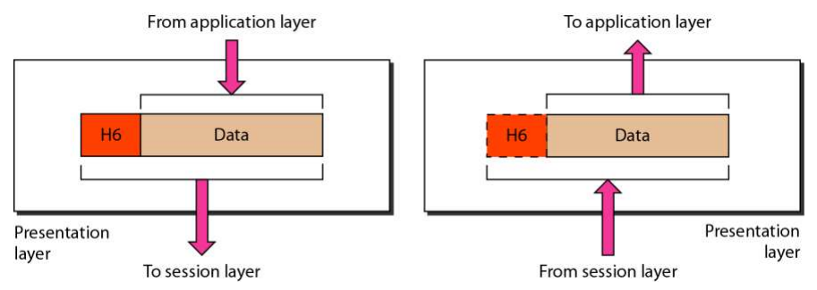
The presentation layer is responsible for translation, compression, and encryption

Slide 29
Application layer
This is the only layer that directly interacts with data from the user. Software applications like web browsers and email clients rely on the application layer to initiate communications.
But it should be made clear that client software applications are not part of the application layer; rather the application layer is responsible for the protocols and data manipulation that the software relies on to present meaningful data to the user.
Application layer protocols include HTTP as well as SMTP (Simple Mail Transfer Protocol is one of the protocols that enables email communications).

Slide 30
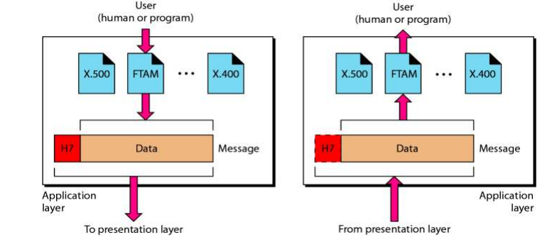
The application layer is responsible for providing services to the user

Slide 31
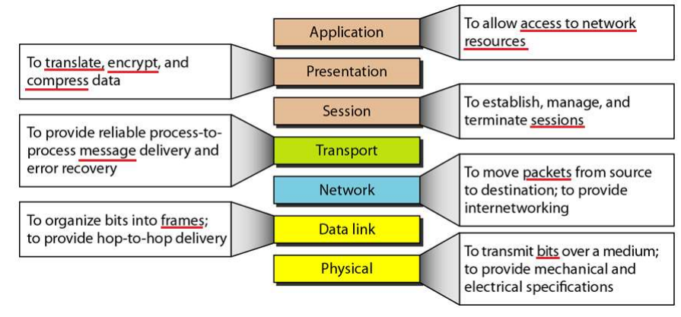
Summary of layers

Slide 32
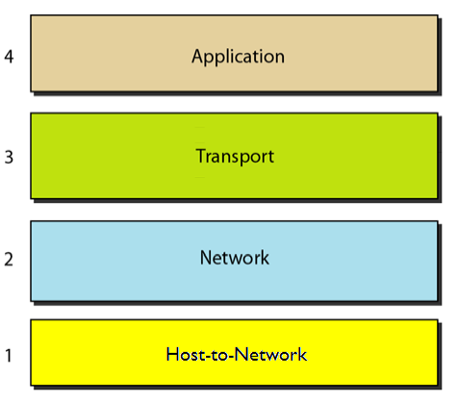
TCP/IP PROTOCOL SUITE
The original TCP/IP protocol suite was defined as having four layers : host-to-network, network(internet), transport and application

Slide 33
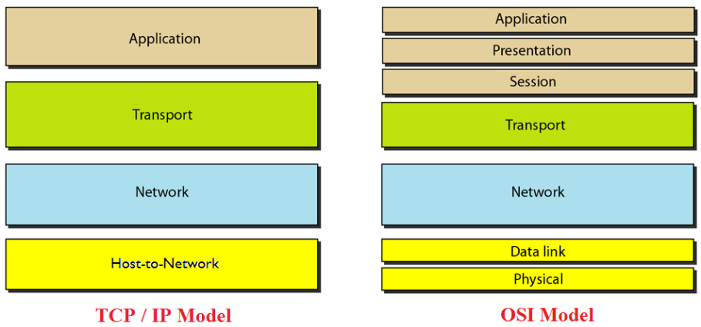
The layers in the TCP/IP protocol suite do not exactly match those in the OSI model.
However, when TCP/IP is compared to OSI, we can say that the TCP/IP protocol suite is made of five layers: physical, data link, network, transport, and application

Slide 34
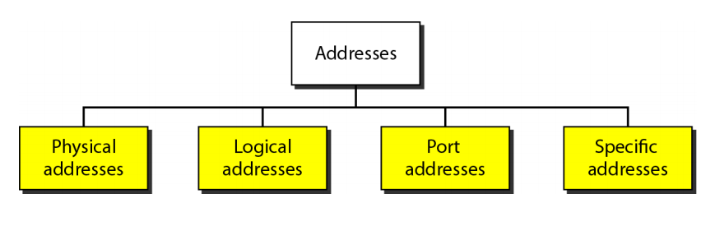
ADDRESSING
Four levels of addresses are used in an internet employing the TCP/IP protocols: physical, logical, port, and specific

Slide 35
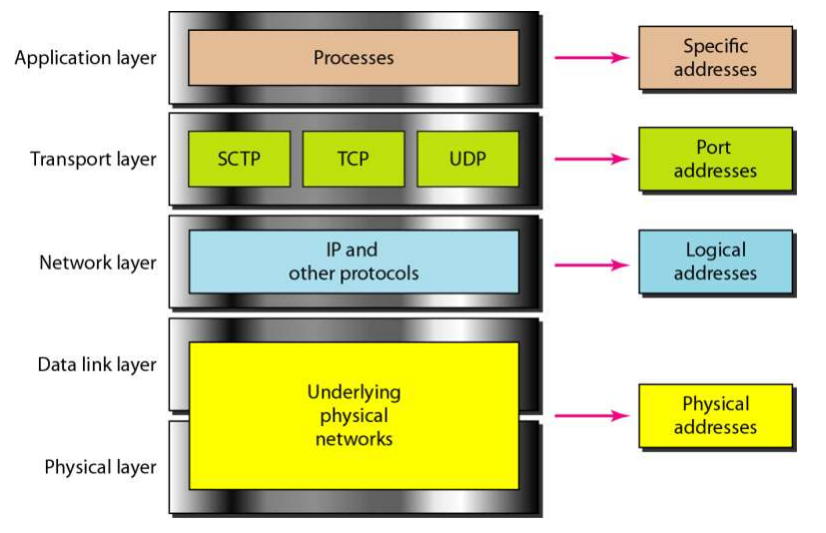
Relationship of layers and addresses in TCP/IP (Internet Model)

Slide 36
Physical Address
The physical address, also known as the link address, is the address of the node as defined by its LAN or WAN.
It is included in the frame used by the data link layer.
It is the lowest-level address.

Slide 37
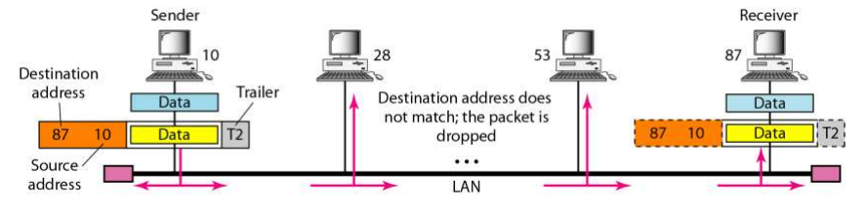
Example
In Figure below a node with physical address 10 sends a frame to a node with physical address 87. The two nodes are connected by a link (bus topology LAN). As the figure shows, the computer with physical address 10 is the sender, and the computer with physical address 87 is the receiver.

Slide 38
Logical Address
A logical address in the Internet is currently 32-bit address that can uniquely define a host connected to the Internet.
No two publicly addressed and visible hosts on the Internet can have the same IP address.
Example
Figure in the next slide shows a part of an internet with two routers connecting three LANs. Each device (computer or router) has a pair of addresses (logical and physical) for each connection. In this case, each computer is connected to only one link and therefore has only one pair of addresses. Each router, however, is connected to three networks (only two are shown in the figure). So each router has three pairs of addresses, one for each connection.

Slide 39
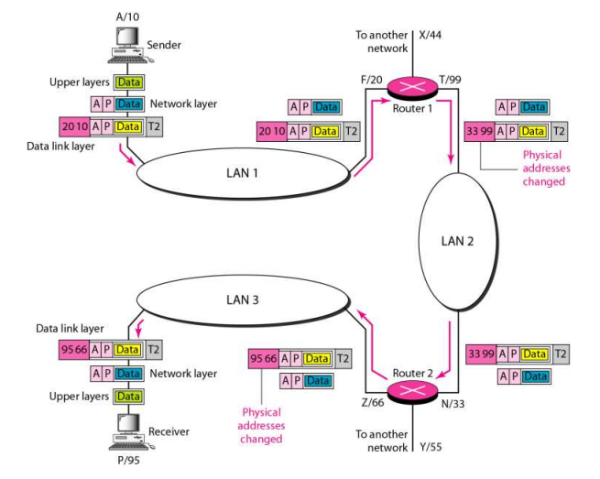

Slide 40
Port Address
In TCP / IP model, the label assigned to a process is called a port address.
A port in TCP / IP is 16-bits in length
Example
Figure in the next slide shows two computers communicating via the Internet. The sending computer is running three processes at this time with port addresses a, b, and c. The receiving computer is running two processes at this time with port addresses j and k. Process a in the sending computer needs to communicate with process j in the receiving computer. Note that although physical addresses change from hop to hop, logical and port addresses remain the same from the source to destination.

Slide 41
